Slide 1

SPARK

Slide 2
Contents
Spark Caching
Memory Management

Slide 3

Spark Caching
Apache Spark provides an important feature to cache intermediate data and provide significant performance improvement while running multiple queries on the same data.
How to cache

Slide 4
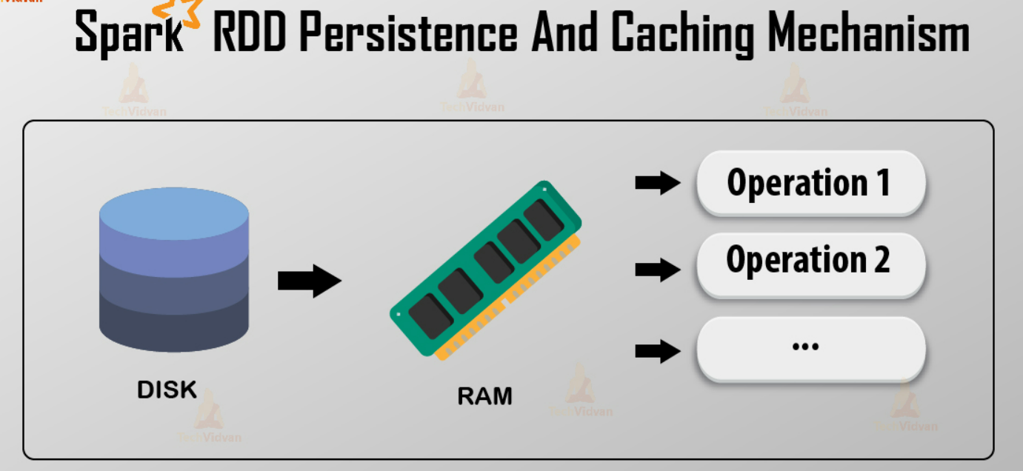

Slide 5
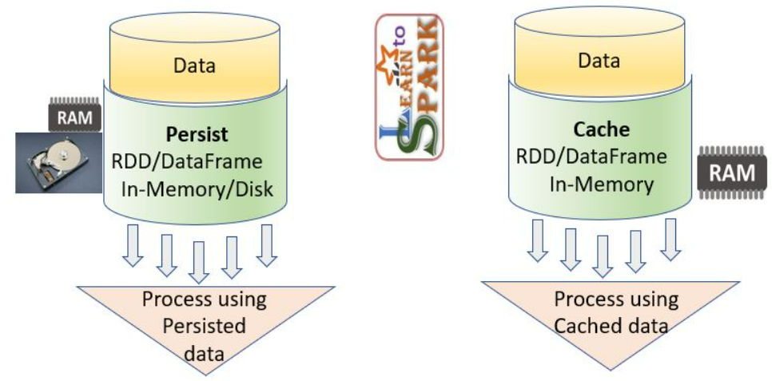

Slide 6

The cache method calls persist method with default storage level MEMORY_AND_DISK.
When to cache
The rule of thumb for caching is to identify the Dataframe that you will be reusing in your Spark Application and cache it.
Even if you don’t have enough memory to cache all of your data you should go-ahead and cache it. Spark will cache whatever it can in memory and spill the rest to disk.

Slide 7
Benefits of caching DataFrame
Reading data from source(hdfs:// or s3://) is time consuming. So after you read data from the source and apply all the common operations, cache it if you are going to reuse the data.
By caching you create a checkpoint in your spark application and if further down the execution of application any of the tasks fail your application will be able to recompute the lost RDD partition from the cache.

Slide 8
If you don’t have enough memory data will be cached at the local disk of executor which will also be faster than reading from the source.
If you can only cache a fraction of data it will also improve the performance, the rest of the data can be recomputed by spark and that’s what resilient in RDD means.

Slide 9
Caching methods in Spark
We can use different storage levels for caching the data.
DISK_ONLY: Persist data on disk only in serialized format.
MEMORY_ONLY: Persist data in memory only in deserialized format.
MEMORY_AND_DISK: Persist data in memory and if enough memory is not available evicted blocks will be stored on disk.
OFF_HEAP: Data is persisted in off-heap memory.

Slide 10
We can explicitly specify whether to use replication while caching data by using methods such as DISK_ONLY_2, MEMORY_AND_DISK_2, etc.
We can also specify whether to serialize data while storing. Methods like MEMORY_ONLY_SER etc. Using serialized format will increase processing time but decrease the memory footprint.
Serialization with replication is also available e.g. MEMORY_ONLY_SER_2

Slide 11
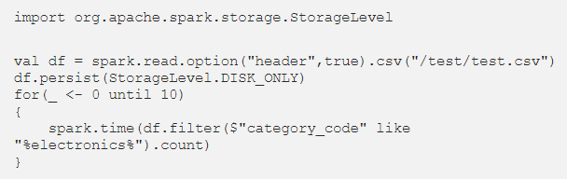
Comparison between different storage levels
Below tests are run on the local machine with 12GB driver memory and input data of size 14GB and time was recorded using `spark.time` for each iteration.
It outputs run time of a query which was executed 10 times in a loop.

Slide 12
cache() in spark is lazily evaluated. So when first action was called, at that time data will be cached.
Caching will take additional time which can be seen in the graph above.
For re-runs we observe significant performance benefit with cache

Slide 13
Caching is an important technique to optimize spark jobs.
We should cache our data if we are going to use it multiple times in our code.
It can give us a significant performance benefit.

Slide 14
Memory Management
Memory management is at the heart of any data-intensive system.
Spark, in particular, must arbitrate memory allocation between two main use cases: buffering intermediate data for processing (execution) and caching user data (storage).
One of Spark’s selling points is that it takes 10-100x less time to finish a similar job written as Hadoop Map-Reduce. The trick is to store data reliably in in-memory – this makes repeatedly accessing it (ie. for iterative algorithms) incomparably faster.

Slide 15
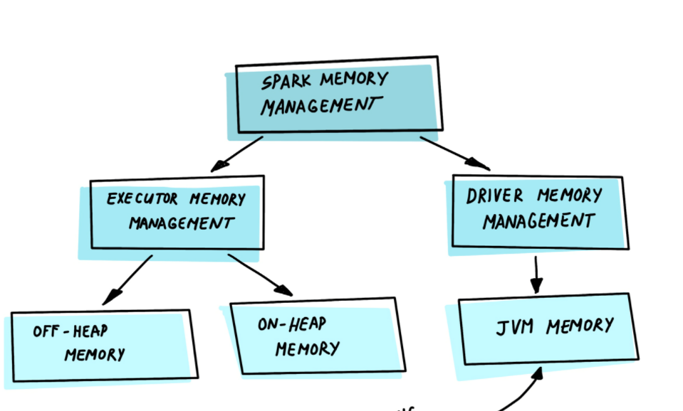
Let's understand first, what memory regions available in Spark.
An executor is the Spark application’s JVM process launched on a worker node.
It runs tasks in threads and is responsible for keeping relevant partitions of data.
Each process has an allocated heap with available memory (executor/driver).

Slide 16
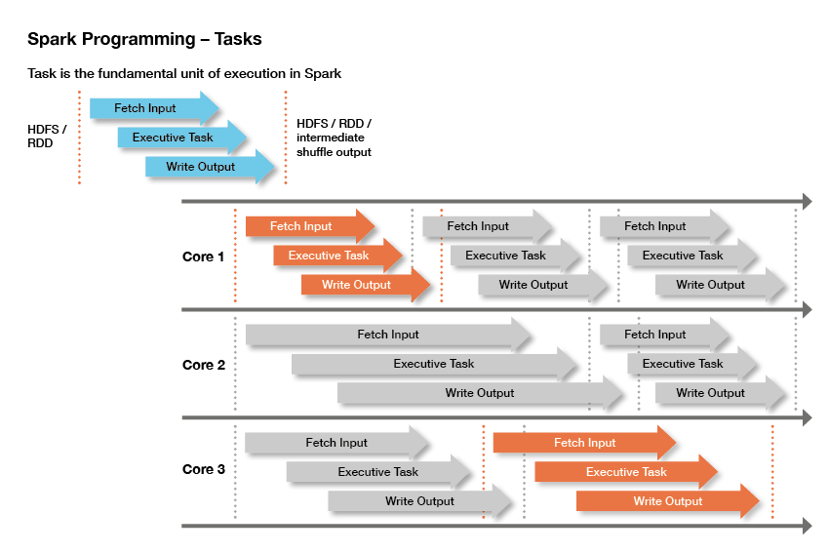

Slide 17
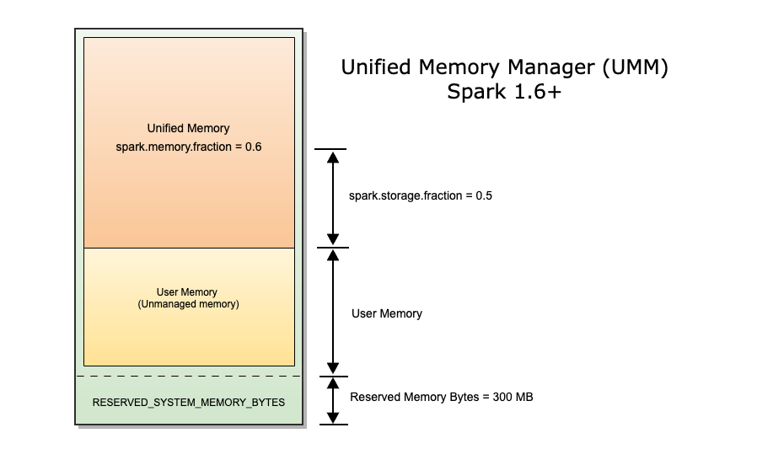
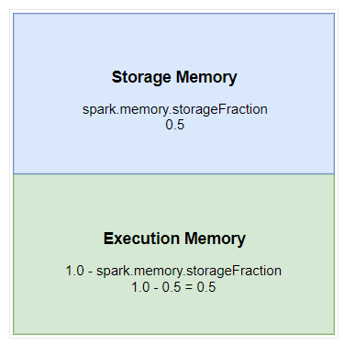
Spark Memory Management Model

Slide 18
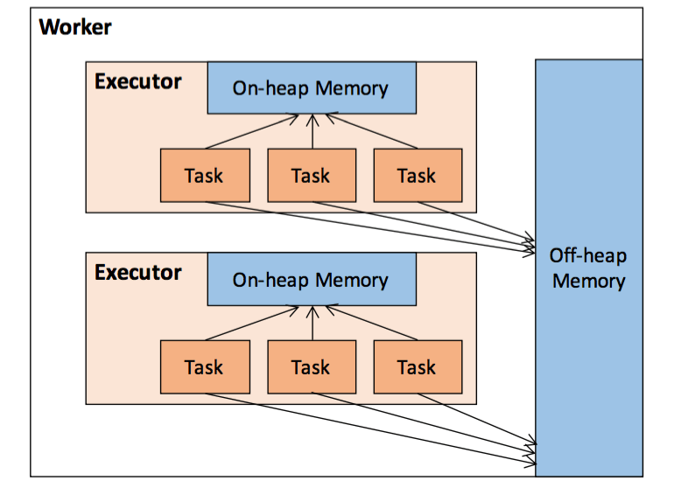

Slide 19
There are 3 main memory regions. These memories (regions) governed by spark.memory.fraction which has the default value 0.6
Reserved Memory
This is the memory reserved by the system, and its size is hardcoded.
As of Spark 1.6.0, its value is 300MB, which means that this 300MB of RAM does not participate in Spark memory region size calculations, and its size cannot be changed in any way without Spark recompilation or setting spark.testing.reservedMemory, which is not recommended as it is a testing parameter not intended to be used in production.

Slide 20
Be aware, this memory is only called “reserved”, in fact it is not used by Spark in any way, but it sets the limit on what you can allocate for Spark usage.
Even if you want to give all the Java Heap for Spark to cache your data, you won’t be able to do so as this “reserved” part would remain spare (not really spare, it would store lots of Spark internal objects).
For your information, if you don’t give Spark executor at least 1.5 * Reserved Memory = 450MB heap, it will fail with “please use larger heap size” error message.

Slide 21
User Memory
This is the memory pool that remains after the allocation of Spark Memory, and it is completely up to you to use it in a way you like.
You can store your own data structures there that would be used in RDD transformations.
For example, you can rewrite Spark aggregation by using mapPartitions transformation maintaining hash table for this aggregation to run, which would consume so called User Memory.

Slide 22
In Spark, the size of this memory pool can be calculated as (“Java Heap” – “Reserved Memory”) * (1.0 – spark.memory.fraction), which is by default equal to (“Java Heap” – 300MB) * 0.40.
For example, with 4GB heap you would have 1518 MB of User Memory.
And again, this is the User Memory and its completely up to you what would be stored in this RAM and how, Spark makes completely no accounting on what you do there and whether you respect this boundary or not.
Not respecting this boundary in your code might cause OOM error.

Slide 23
Spark Memory ( Unified Memory )
This is the memory pool managed by Apache Spark. Its size can be calculated as (“Java Heap” – “Reserved Memory”) * spark.memory.fraction, and with Spark 1.6.0 defaults it gives us (“Java Heap” – 300MB) * 0.6.
For example, with 4GB heap this pool would be 2578 MB in size.

Slide 24
This whole pool is split into 2 regions – Storage Memory and Execution Memory, and the boundary between them is set by spark.memory.storageFraction parameter, which defaults to 0.5.
The advantage of this new memory management scheme is that this boundary is not static, and in case of memory pressure the boundary would be moved, i.e. one region would grow by borrowing space from another one.

Slide 25
Spark tasks operate in two main memory regions:
Execution – used for shuffles, joins, sorts, and aggregations
Storage – used to cache partitions of data
Execution memory tends to be more “short-lived” than storage. It is evicted immediately after each operation, making space for the next ones.
In terms of storage, two main functions handle the persistence of data –RDD’s cache() and persist().

Slide 26
END OF SESSION
Q&A

